Slide 1

POWER BI PROJECT
REPORT
Columbia Asia Hospital
Monika Singh

Slide 2

Data Description
Date: This column contains date and time information without specifying AM or PM. The format is DD-MM-YYYY HH:MM.
Patient ID: Each patient is assigned a unique identifier, which seems to be in the format 124-62-3289.
Patient Gender: This column records the gender of the patient, denoted by 'M' for male and 'F' for female.
Patient Age: The age of the patients is listed in years.
Patient Sat Score: It seems to represent a satisfaction score given by or for the patient. However, the scores are single-digit, and it's not clear what the scale is.
Patient First Initial: This column contains the first initial of the patient's first name.
Patient Last Name: The surname of the patient is listed in this column.
Thynk Unlimited
Patient Race: The racial or ethnic background of the patient is recorded here, with categories such as 'White', 'African American', 'Asian', 'Native American/Alaska Native', and 'Two or More Races'.
Patient Admin Flag: This column contains Boolean values ('TRUE' or 'FALSE') which might indicate whether the patient was admitted or some other administrative flag.
Patient Wait Time: Appears to indicate the time the patient waited, possibly in minutes, before being seen or processed.
Department Referral: This column lists the department to which the patient was referred, with entries such as 'General Practice', ‘Orthopaedics’, 'Gastroenterology', or 'None' indicating no referral.
Doctor Name: Identifies the doctor who attended each patient.
Appointment Fees: The cost charged for a doctor's consultation.
Total Bill: The overall amount billed to the patient, including all services and charges.

Slide 3
Problem Statements
In analyse the hospital dataset with Power BI, ensure data cleaning to address inconsistencies and missing values before further analysis.
Assess the Average Waiting Time: Analyse the patient wait times to identify the average duration a patient spends before receiving care.
Visits by Department Referral: Calculate the total number of visits to each department based on referrals to understand which departments are most frequently visited.
Patient Visits by Age Group: Segregate patient visits according to different age groups to see which demographics utilize healthcare services the most.

Slide 4
Problem Statements
What is the relation between patient wait time and satisfaction scores?
• Investigate whether longer wait times are associated with lower patient satisfaction across various departments.
How do patient demographics affect the frequency of visits to different departments?
• Analyse visit patterns to see if certain age groups or races are more likely to be referred to specific departments.
Is there a noticeable trend in the volume of patient visits throughout the year?
• Examine patient visit data to identify any seasonal trends or particular months with increased healthcare facility usage.
Which age groups report the highest and lowest satisfaction scores?
• Calculate the average satisfaction scores within each age group to identify which age demographics report the best and worst experiences.

Slide 5
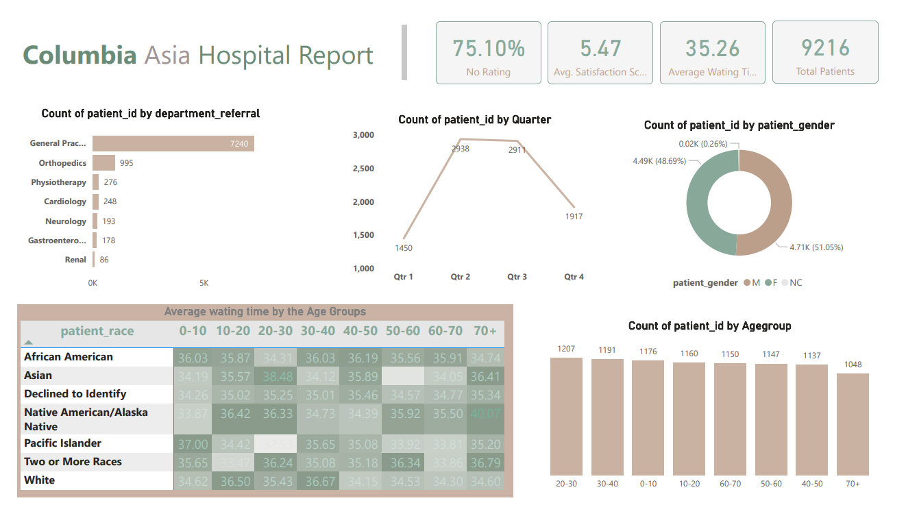
OVERVIEW OUR DASHBOARD
Thynk Unlimited

Slide 6
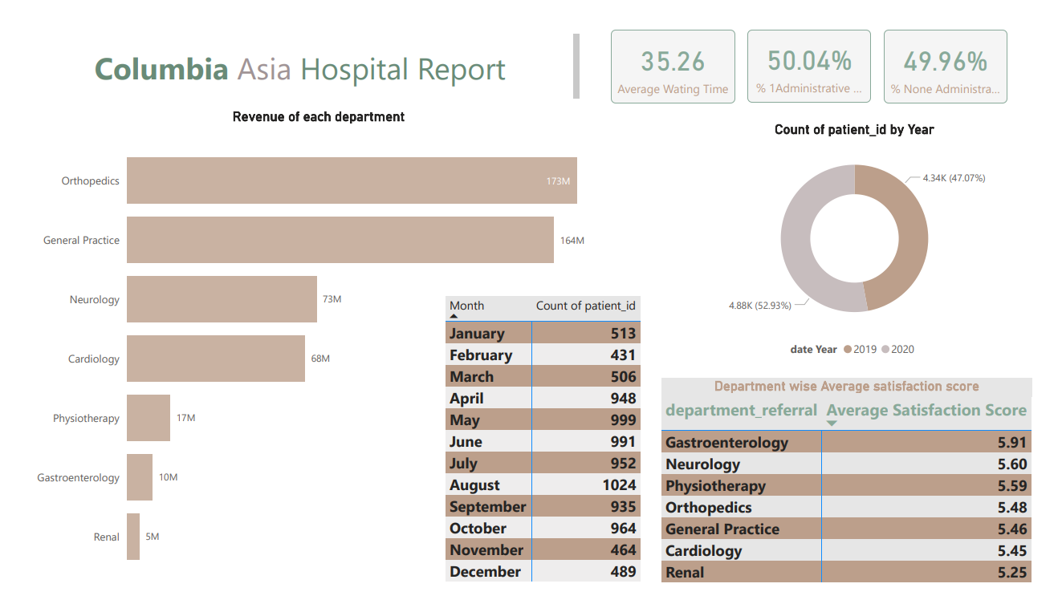
OVERVIEW OUR DASHBOARD
Thynk Unlimited

Slide 7
01
Average Waiting Time:
35.26
Static Insights:
02
Total number of patients:
9216
03
Average satisfaction score :
5.47

Slide 8
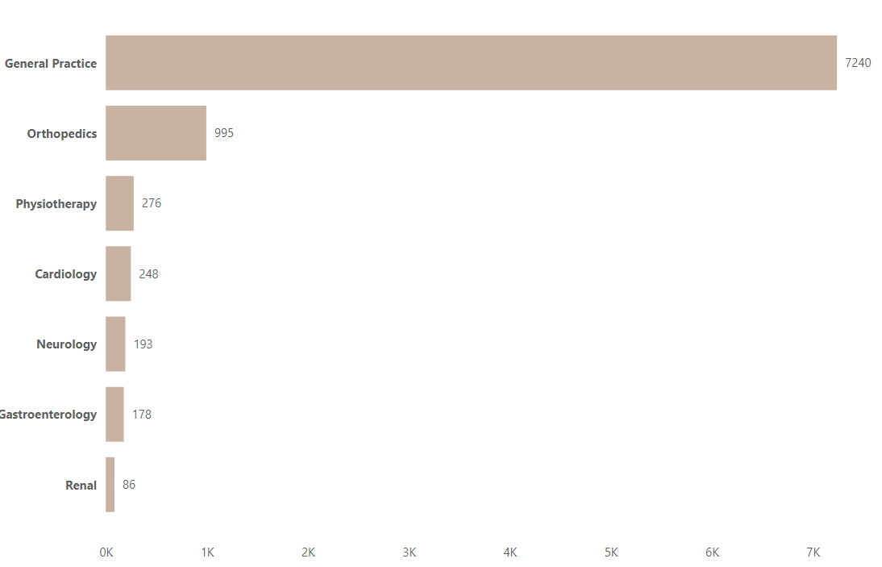
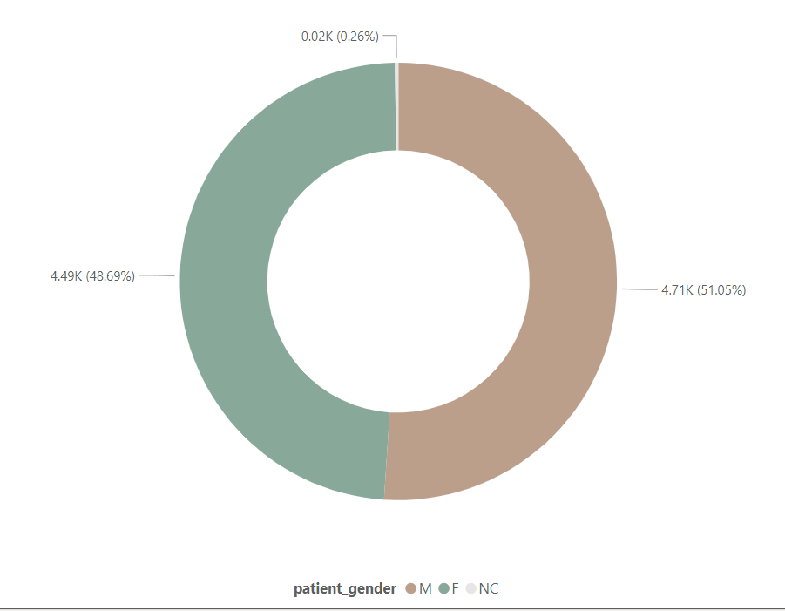
PATIENT VISITS BY DEPAREMENT & GENDER
Patient Visits by Department Referral:
Patient Visits by Gender M/F :

Slide 9
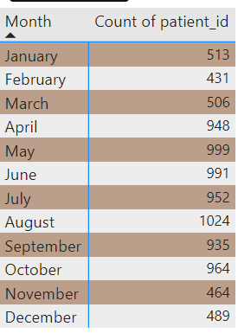
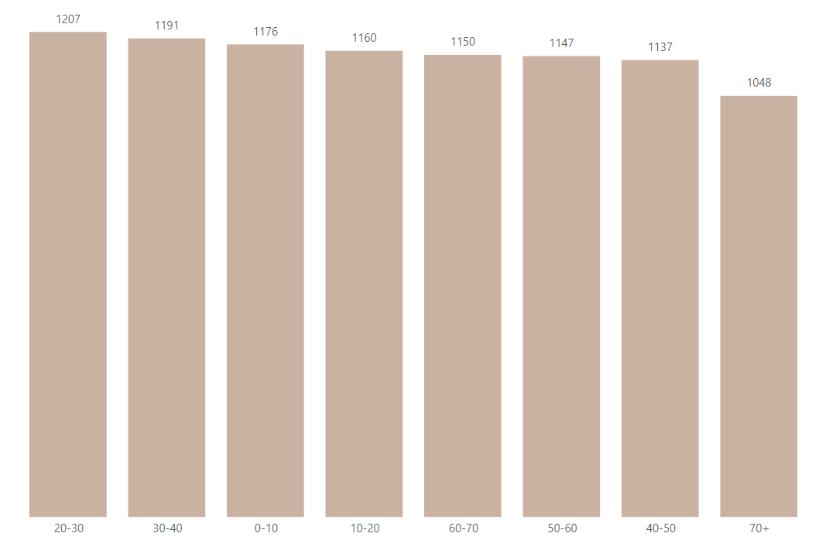
PATIENT VISITS BY AGE GROUP & MONTH’S
Patient Visits by Age group :
Patient Visits by Month’s:

Slide 10
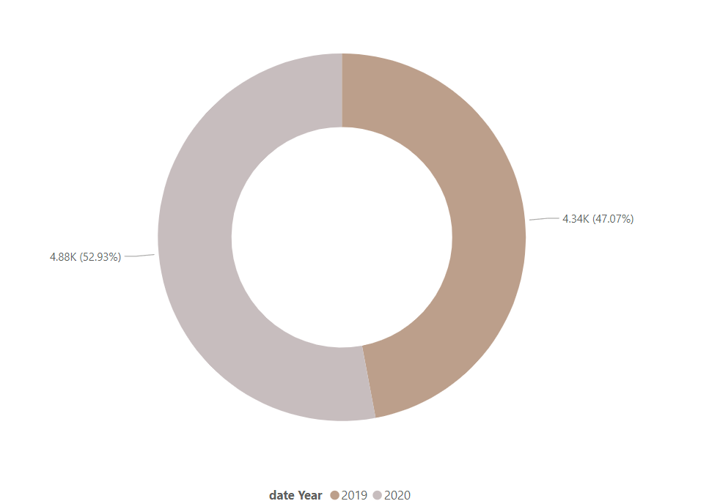
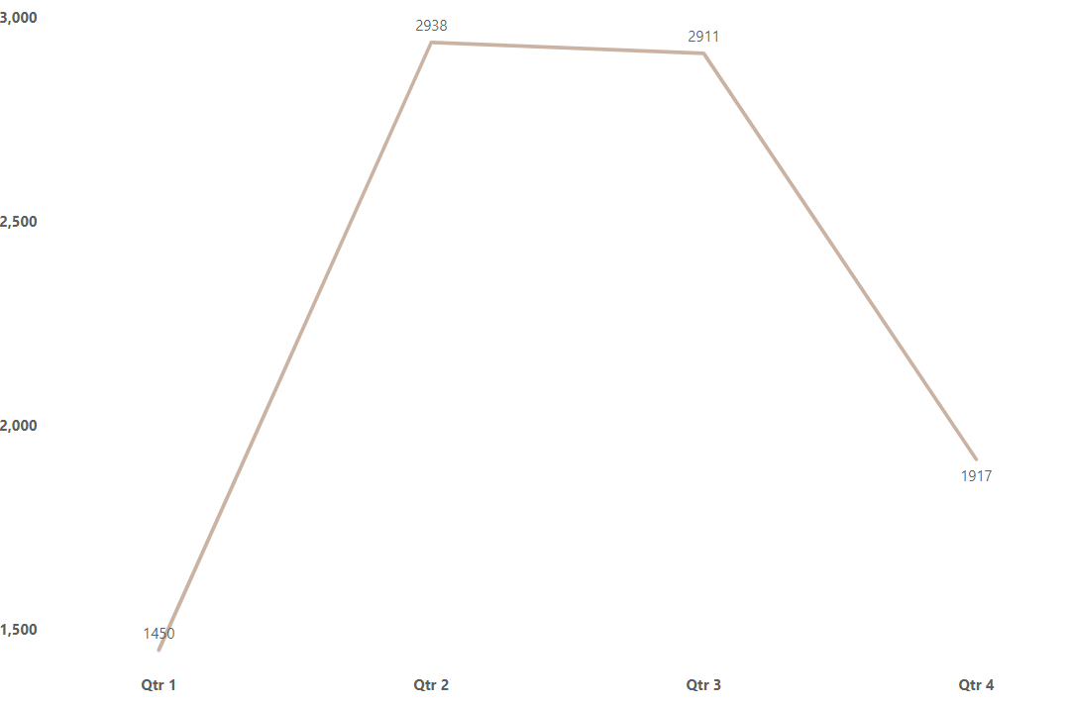
PATIENT VISITS BY QUARTER & YEAR
Patient Visits by Quarter:
Patient Visits by Year:

Slide 11
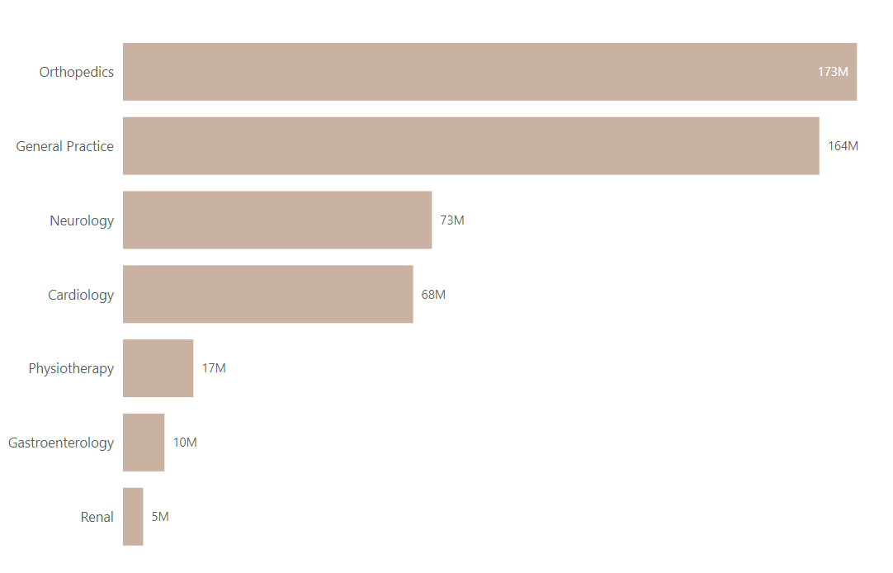
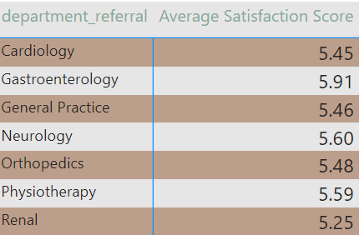
REVENUE & AVERAGE SATISFACTION SCORE
Revenue of each department :
Average satisfaction by department referral:

Slide 12
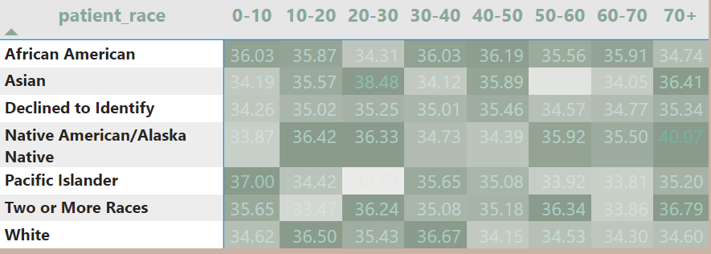
Average waiting time by the Age Groups according to patient race
Thynk Unlimited

Slide 13

THANK YOU
FOR YOUR ATTENTION
Monika Singh

